Slide 1
Health Awareness and Nutrition:
Department of Clinical Nutrition and Dietetics College of Health Sciences
Lecture 5:Lipids

Slide 2
Introduction
Lipids are organic compounds that are insoluble in water but soluble in organic solvents like chloroform, ether, and benzene.
Body fat constitutes approx. 10-30% of total weight (10-20% for adult males, 20-30% for adult females.)
Accumulation of 1 Kg of fat (adipose tissue) corresponds to 7700 Kcal (kilocalories) of energy.

Slide 3
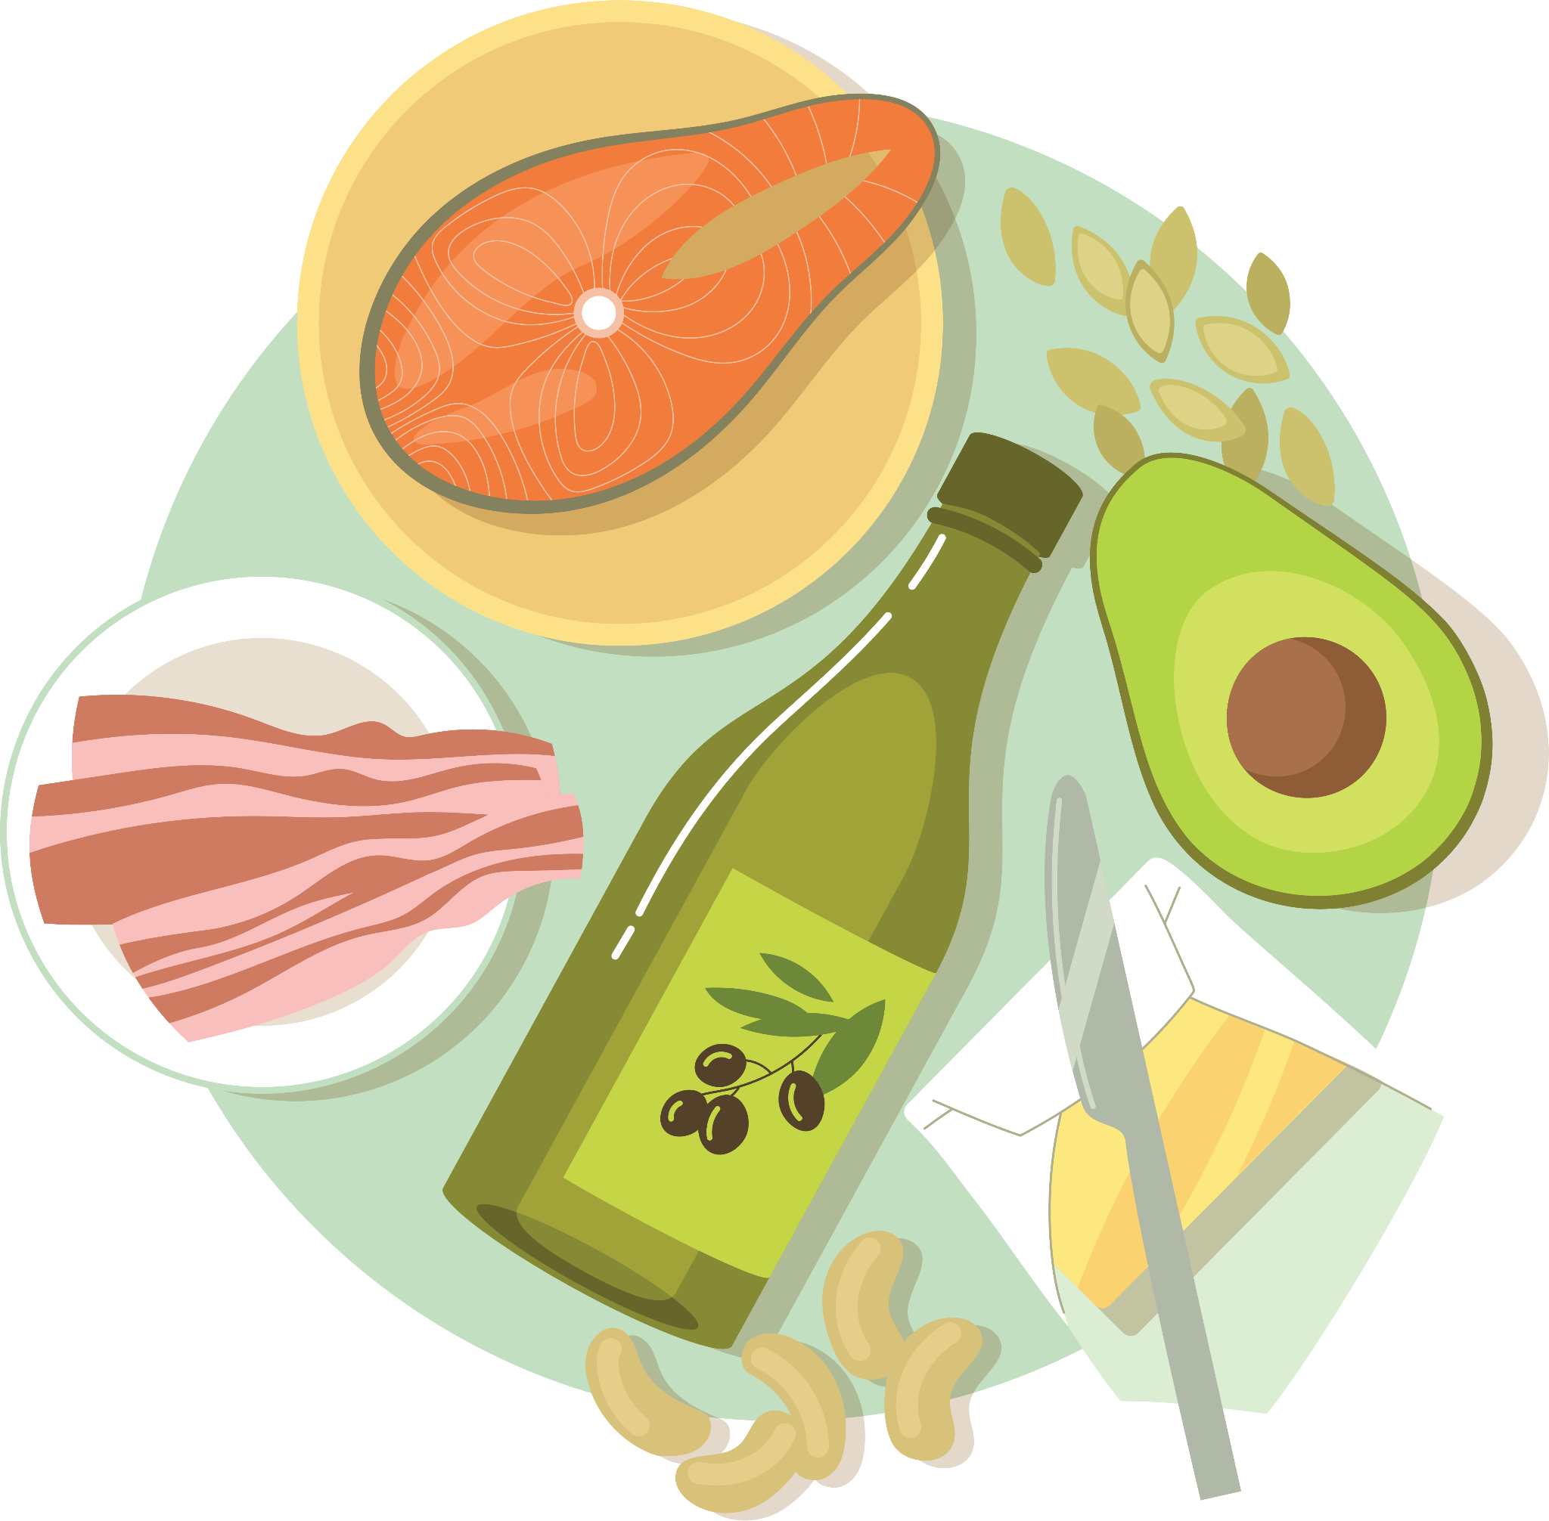
Introduction
Dietary fats come in two forms.
Fats: semi-solid at room temperature (25 ͦC)
Oils: liquid at room temperature
Sources of fats and oils:
Animal fats: butter, margarine, milk, cheese, egg, meat and fish
Vegetable fats: peanuts, sesame seeds, nuts (walnuts, almonds, and pistachios) and coconut
Vegetable oils: olive, soy, sunflower, corn, canola and cottonseed oils.

Slide 4
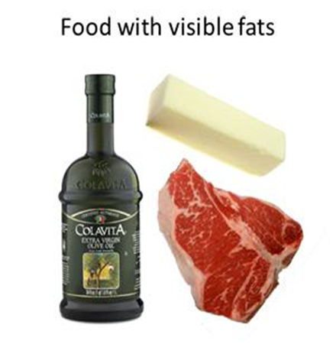
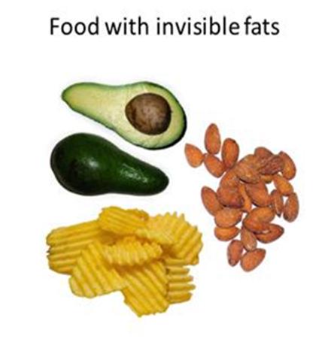
Fat: Sources and Types
Animal fats
Butter, margarine, milk, cheese, eggs, fat of meat & fish
Sources
Vegetable fats (oils)
Seeds of peanut, sesame, nuts (whole nut, peanuts), coconut
Visible fat
Separated from their natural source, used mainly in cooking
Butter, margarine, oil, white parts in meat
Types
Invisible fat
Not visible to naked eyes. Part of natural food
Part of milk, cheese, nuts, salad dressings
Notes:
*extra slide (first two slides cover this)

Slide 5
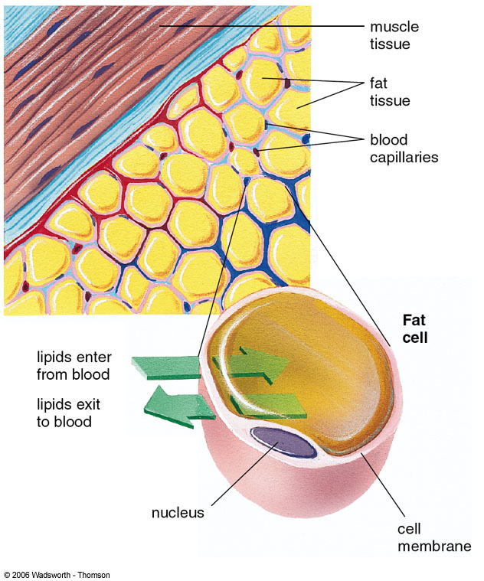
Function of fat in the body
1. Storage form of energy
Fat (triglycerides) is the body’s chief storage form for excess energy consumed
Fat is stored in specialized cells called fat cells or adipocytes that have the ability to enlarge almost indefinitely
Concentrated source of energy:
1 g of fat gives 9 Kcal

Slide 6
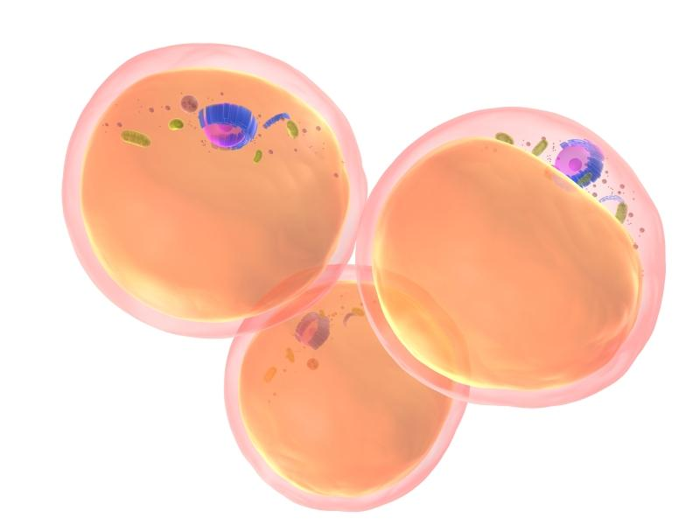
Function of fat in the body
2. Shock absorber
Fat surrounding the internal organs (heart, liver, intestines…) serves as shock absorbers

Slide 7
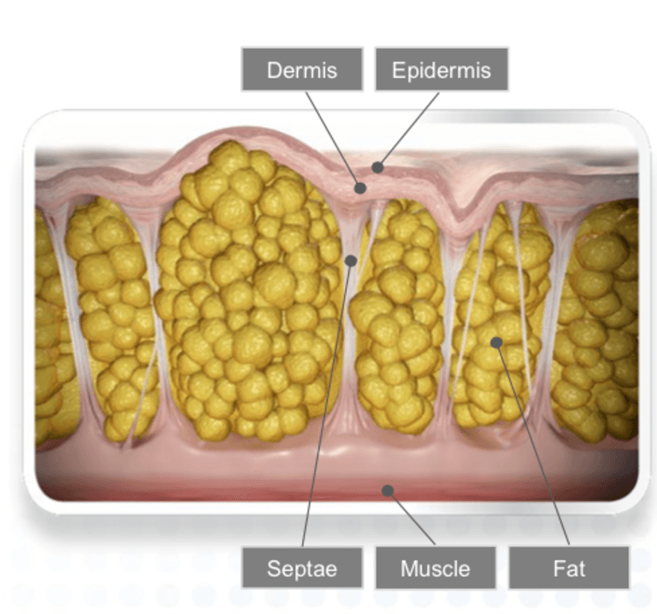
Function of fat in the body
3. Insulating layer
The fat blanket under the skin (adipose tissue) serves as an insulating layer against temperature extremes.
Fat is a poor conductor of heat, so the layer of fat beneath the skin helps keep the body warm
Fat is also part of all cell membranes

Slide 8
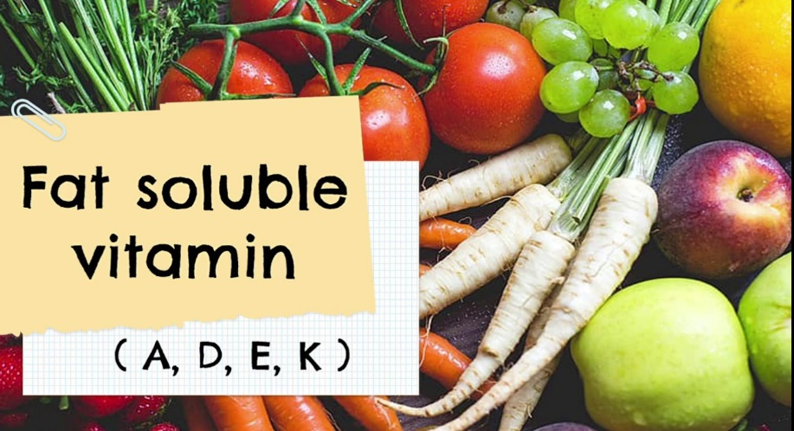
Function of fat in the body
4. Storage place for some vitamins
Vitamins A, D, E, and K are only soluble/found in fat-rich foods and stored in fat within our body

Slide 9
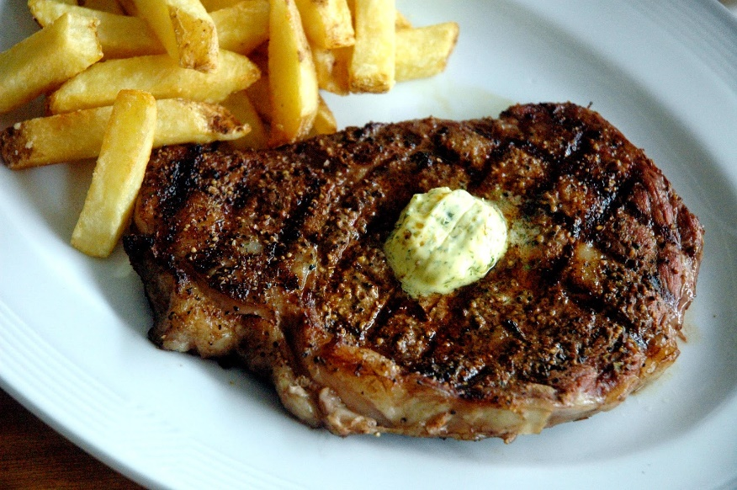
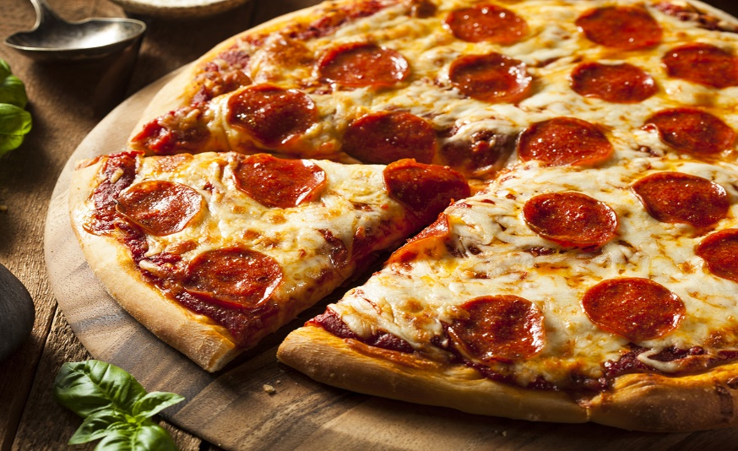
Function of fat in the body
5. Provide taste and satiety
Fat contributes to taste and sensory appeal of foods
People naturally like high-fat foods
Flavors
Tenderness
Fat slows digestion and provides satiety (feeling full)

Slide 10
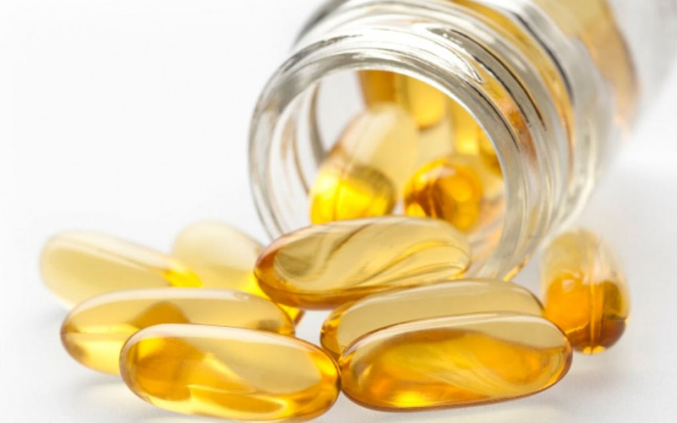
Function of fat in the body
6. Essential fatty acids
Essential fatty acids (omega 3 and omega 6) are needed by the body for growth and structural integrity of cell membranes
7. Cholesterol
Cholesterol helps in the formation of steroid hormones & bile acids

Slide 11
Classification of lipids
Lipids are classified as:
Simple lipids (triglycerides)
Compound lipids (phospholipids) ex.: lecithin in eggs
Derived lipids (Sterols or cholesterol)
The human body can synthesize triglycerides, phospholipids and cholesterol

Slide 12
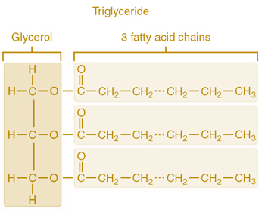
1. Triglycerides
Simple lipids
The most common form of fat in food and the body
Triglyceride= 3 fatty acids + 1 glycerol
Triglycerides: Animal and plant origin
Triglycerides are found in semi-solid fats and liquid oils

Slide 13
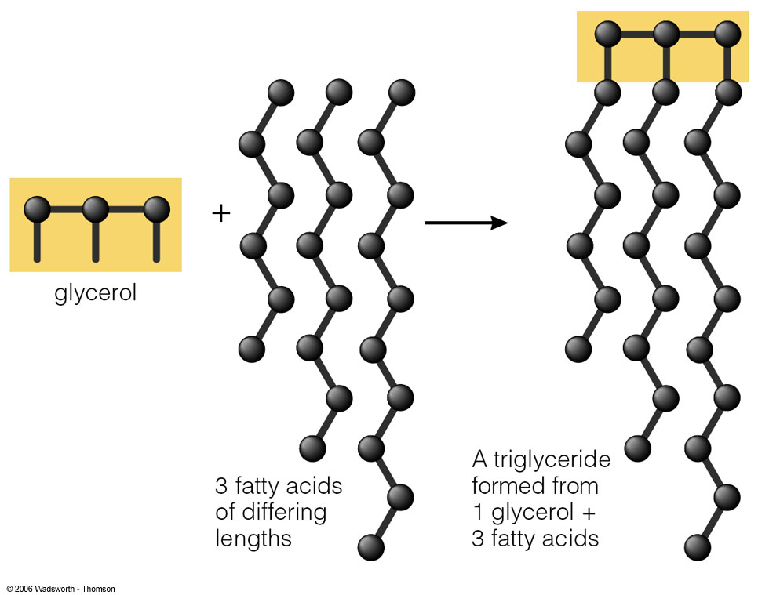
Triglycerides - Fatty acids (FA)
Each FA has a long chain of carbons and hydrogen and at the end a carboxyl group COOH
Each FA differs by length and saturation
FA have an even # of carbon(2-24).
Examples:
→ Olive oil (18 carbons)
→ Palm oil (16 carbons)

Slide 14
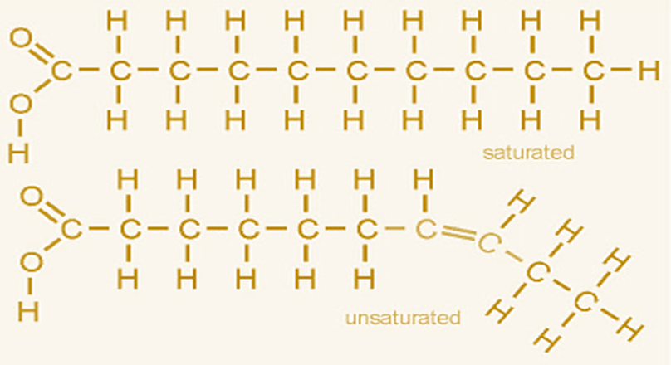

Triglycerides - Fatty acids (FA)
The FA can be:
→ Saturated: (no double bonds)
→ Unsaturated: (1 or more double bonds)

Slide 15
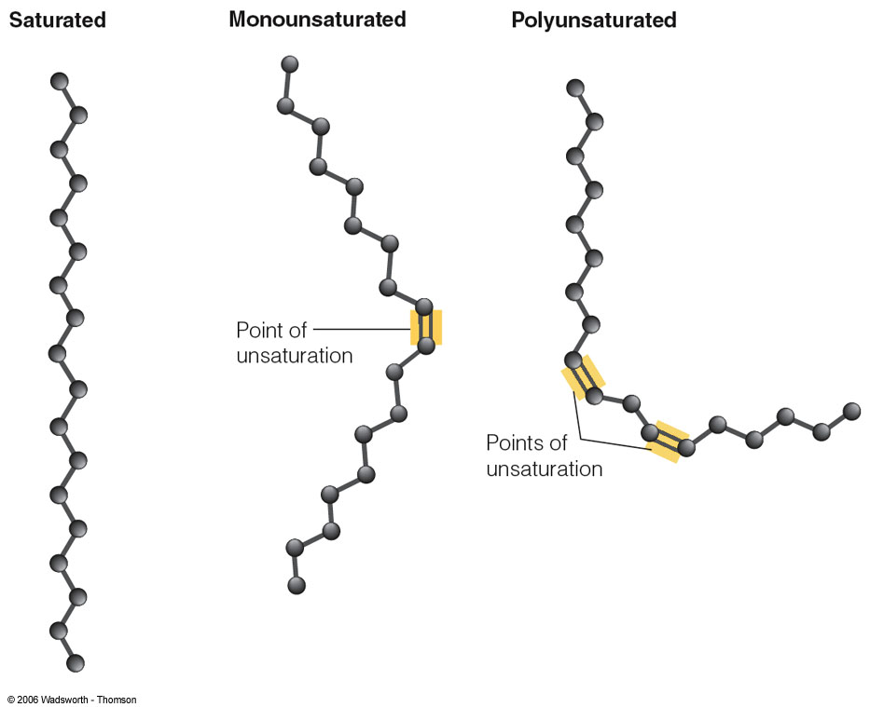
Triglycerides - Fatty acids (FA)
FA are classified according to their degree of saturation (number of double bonds)
Saturated Fatty Acids (SFA)
→ no double bonds
Monounsaturated Fatty Acids (MUFA)
→ one double bond
Polyunsaturated Fatty Acids (PUFA)
→ two or more double bonds

Slide 16
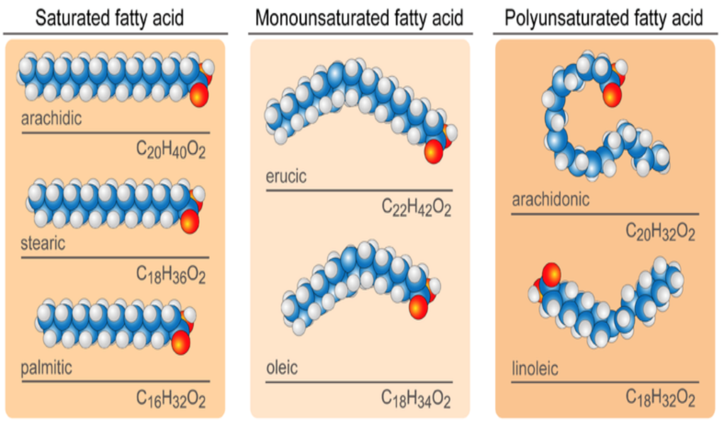
Triglycerides - Fatty acids (FA)
The vast majority of triglycerides contain more than one type of fatty acid.

Slide 17
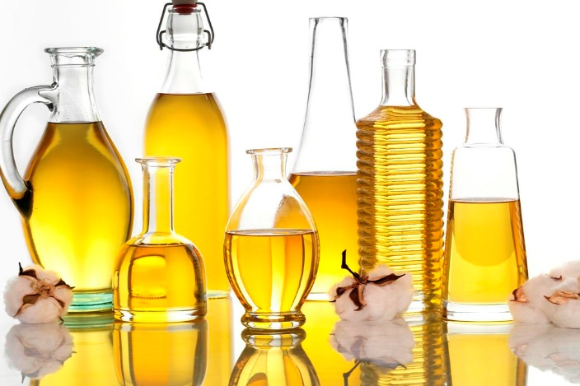
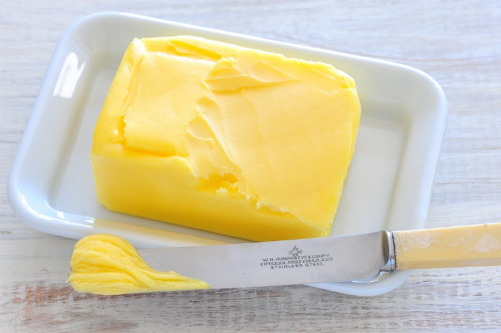
Triglycerides - Fatty acids (FA)
In general, vegetable oils and fish oil are rich in unsaturated FA
Unsaturated FA tend to be more liquid at room temperature (oils)
Unsaturated FA are more healthy
While animal fats are rich in saturated FA
SFA tend to be more solid at room temperature
Saturated FA are more unhealthy

Slide 18
Triglycerides - Saturation
Firmness
→ The degree of unsaturation influences the firmness of fats at room temperature
Stability
→ Saturation also influences stability - all fats become spoiled when exposed to oxygen
→ Saturated fats are most resistant to oxidation and least likely to become rancid
Hydrogenation
→ A chemical process by which hydrogens are added to monounsaturated or polyunsaturated fatty acids to reduce the number of double bonds, making the fats more saturated (solid) and more resistant to oxidation

Slide 19
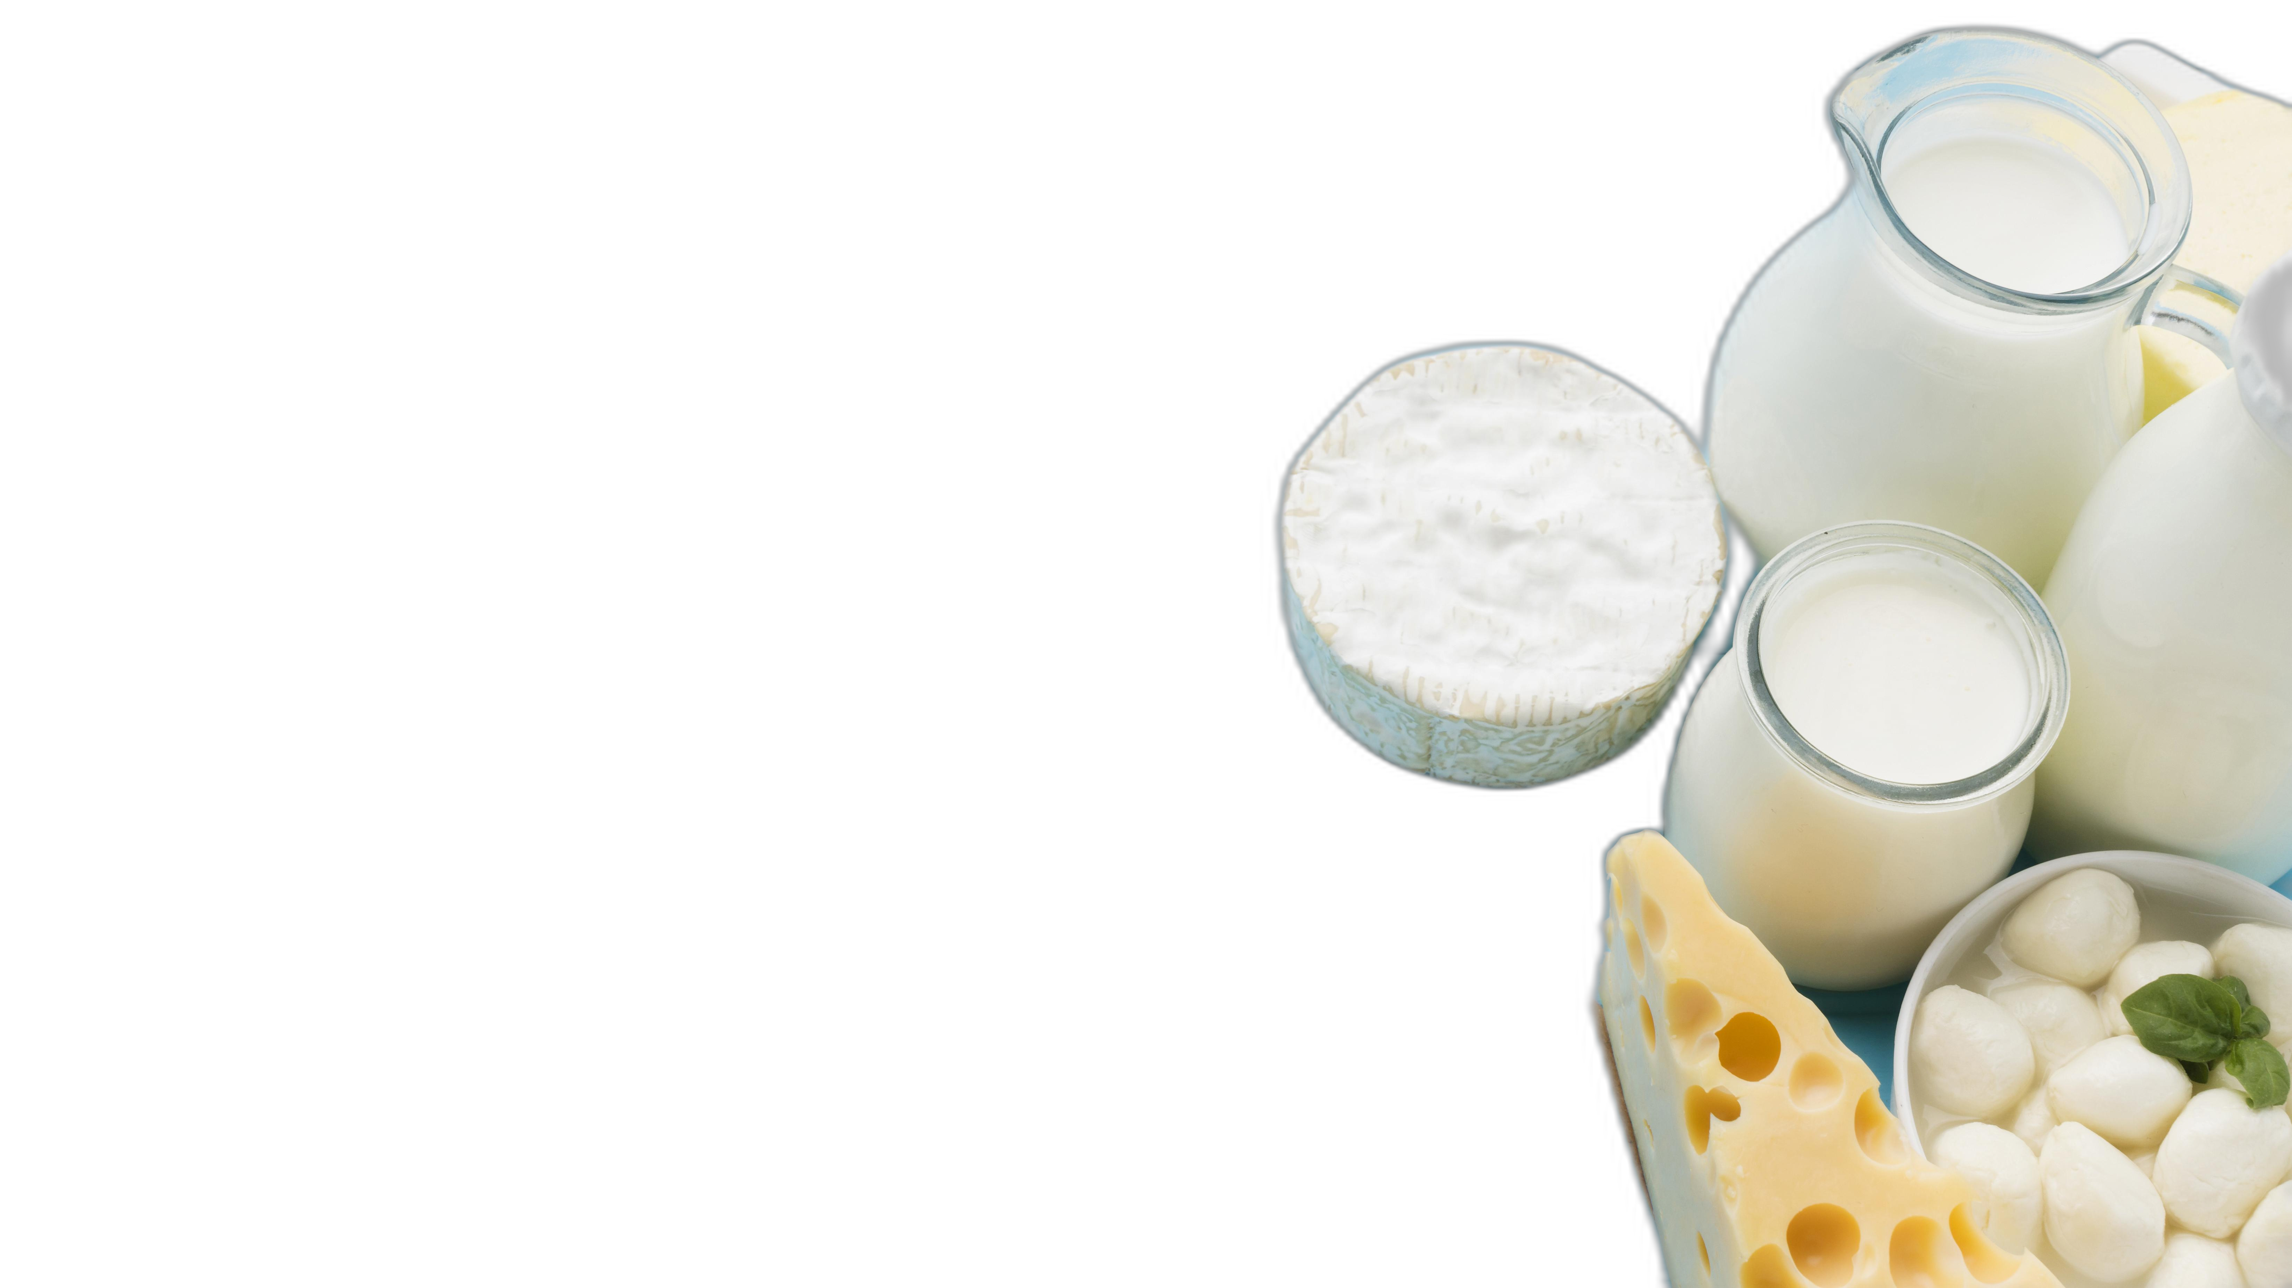
Triglycerides - Fatty acids (FA)
Saturated F.A.
Found in:
Animal products: beef, chicken, fish
Dairy products (milk and cheese)
Butter and margarine
Coconut and palm oil

Slide 20
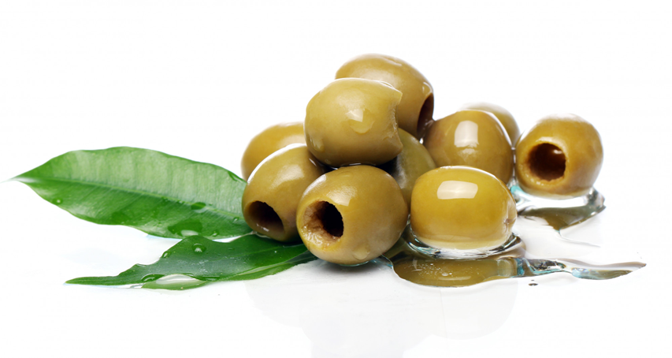
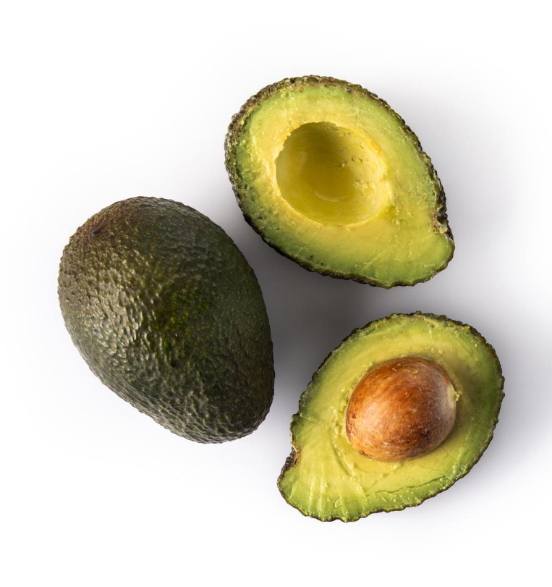
Triglycerides - Fatty acids (FA)
Unsaturated FA
1. MUFA (oleic acid)
Found in:
Olive oil, canola oil, peanut oil
Avocado

Slide 21
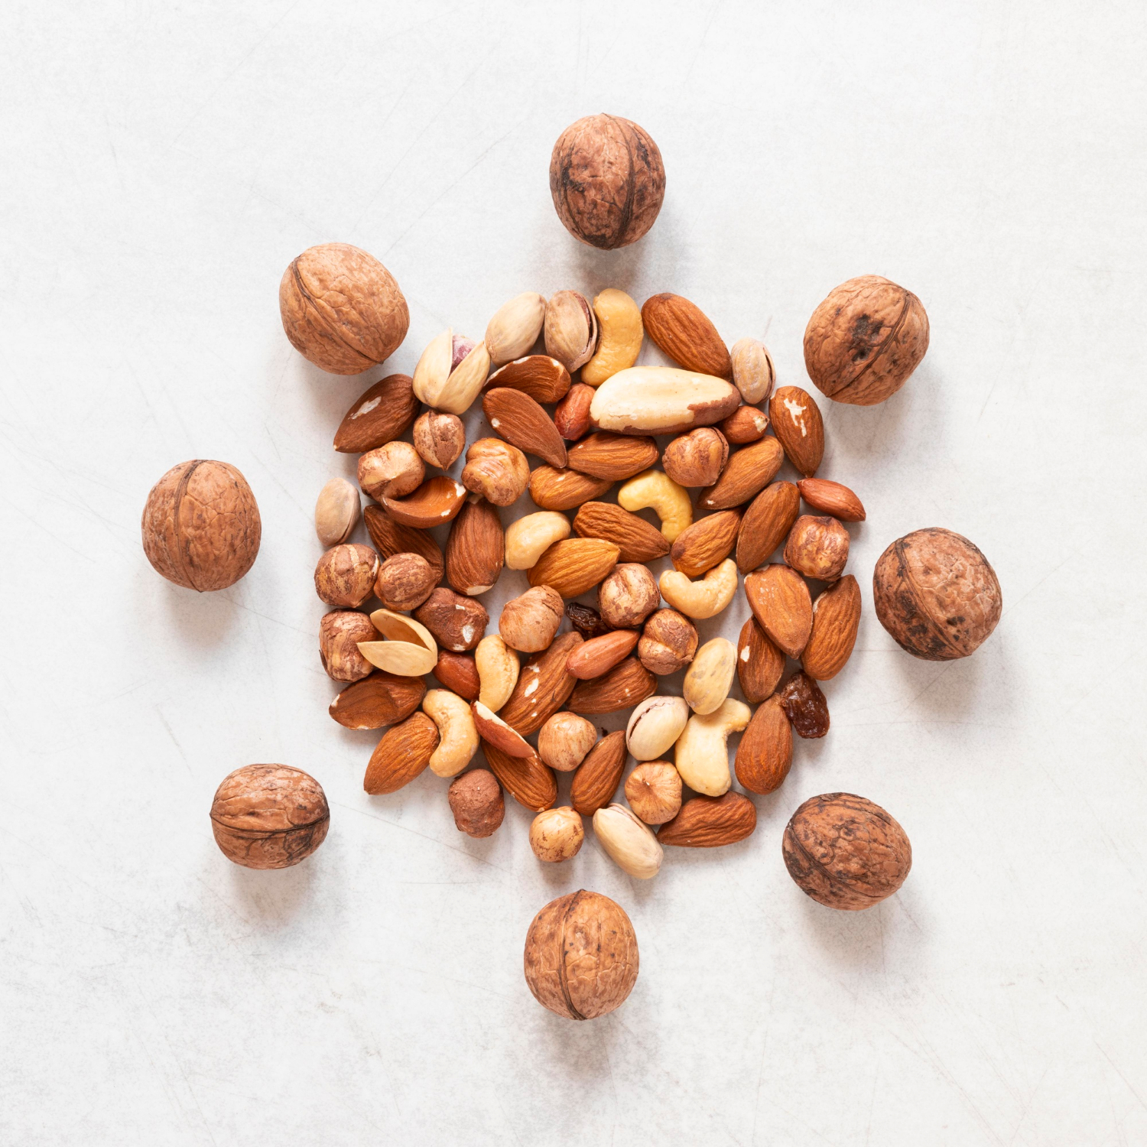
Triglycerides - Fatty acids (FA)
Unsaturated FA
2. PUFA (linolenic acid and linoleic acid) OR omega 3 and 6
Found in:
→ Omega 3
Vegetable oils (canola, soybean, flaxseed),walnuts, flaxseeds, fatty fish (mackerel, salmon, sardines)
→ Omega 6
Vegetable oils (corn, sunflower, safflower, soybean, cottonseed), nuts, seeds

Slide 22
Triglycerides - Fatty acids (FA)
Essential polyunsaturated fatty acids (PUFA)
Linolenic acid
(ω-3)
Linolenic acid
(ω-6)
Cannot be synthesized in the body and thus need to be supplied from the diet
Are nutritionally essential fatty acids and thus are the only lipids that are required components of the human diet
Essential for brain and nerve development and promote normal growth and vision
Recommended to eat fish a minimum 2 times per week
Sometimes is taken as a supplement (ω3 = fish oil)

Slide 23
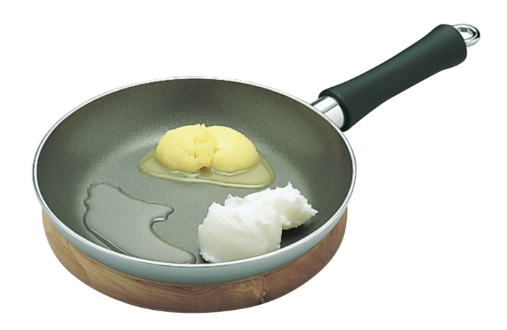
Triglycerides - Fatty acids (FA)
Trans fatty acids
Trans fats are created in an industrial process that transform liquid vegetable oils to make them more solid through hydrogenation
Companies like using trans fats in their foods because they are:
→ Easy to use
→ Inexpensive to produce
→ Can be used many times in commercial fryers

Slide 24
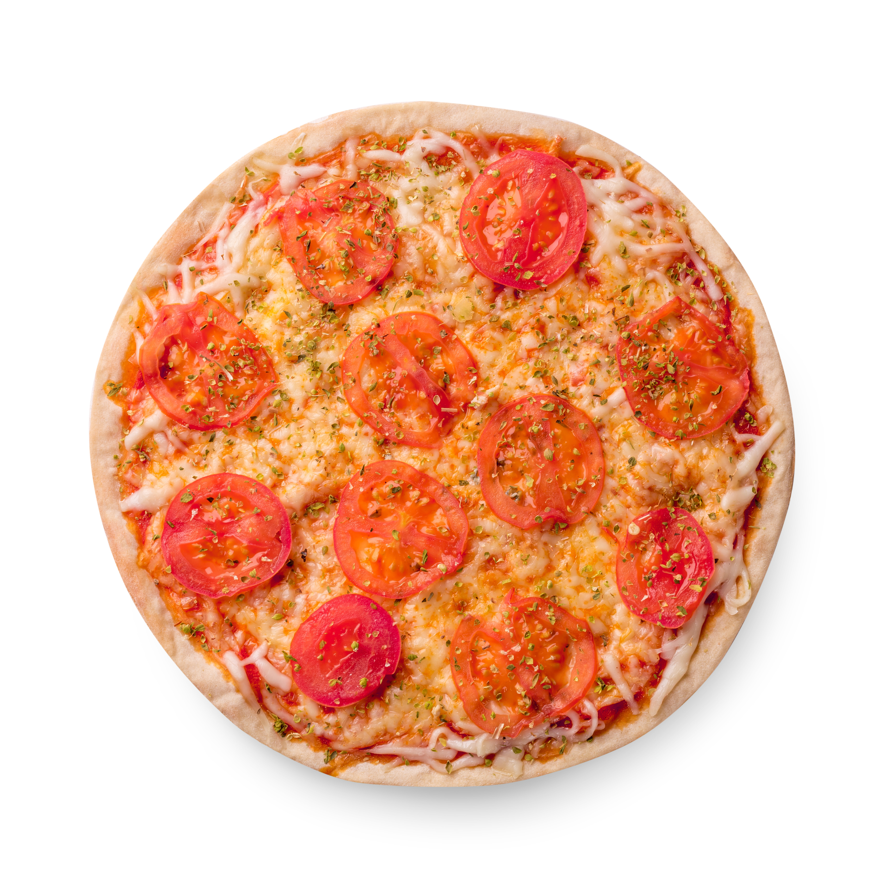
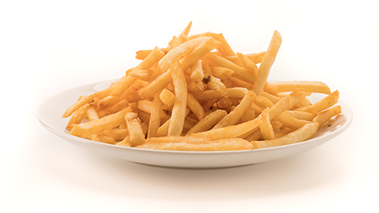

Triglycerides - Fatty acids (FA)
Trans fatty acids
Found in:
Fried foods like french fries and doughnuts
Pastries, pie crusts, biscuits, pizza dough, cookies, crackers
Margarines and shortenings

Slide 25
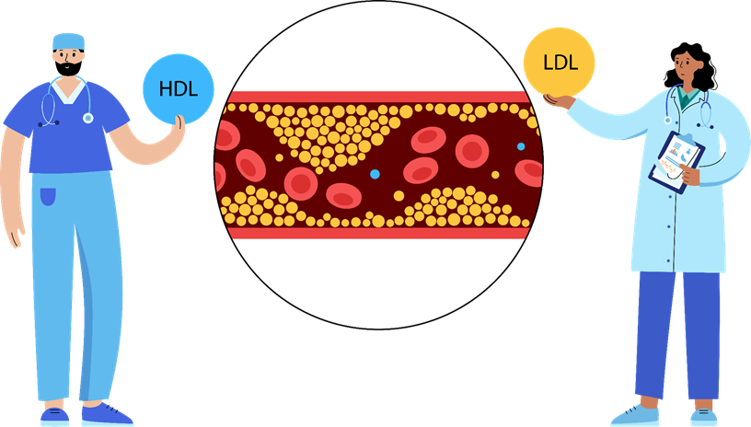
Triglycerides - Fatty acids (FA)
How do trans fats affect health?
Trans fats raise bad (LDL) cholesterol levels and lower good (HDL) cholesterol levels
Eating trans fats increases the risk of developing heart disease and stroke

Slide 26
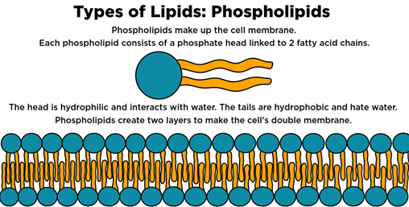
2. Phospholipids
Compound lipids
The best-known phospholipid is lecithin
In the body, phospholipids are part of cell membranes
The food industry uses phospholipids as emulsifiers to mix fats with water
Phospholipids are also found naturally in foods
Food sources: sources of lecithin are eggs, liver, soybeans, wheat germ, and peanuts

Slide 27
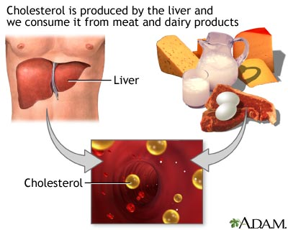
3. Sterols
Derived lipids
The most famous sterol is cholesterol
Sterols other than cholesterol are naturally found in all plants
Plant sterols interfere with cholesterol absorption, and lower blood cholesterol levels
Cholesterol is synthesized in the liver of humans as well as obtained from animal products in the diet
However, our body makes enough cholesterol and thus there is no need to get extra cholesterol from the diet

Slide 28
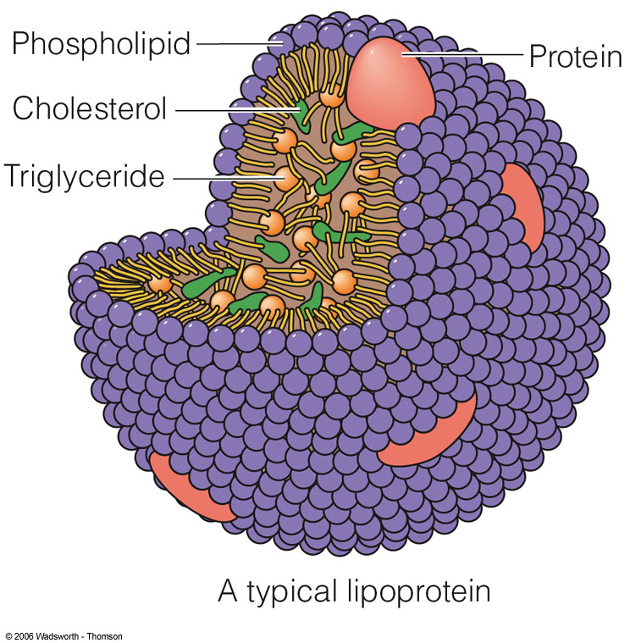
Cholesterol
Cholesterol in the blood is transported in two forms of lipoprotein particles
Low density lipoprotein (LDL)
Called the unhealthy cholesterol
They can build up in the walls of the arteries, making them hard and narrow
High density lipoprotein (HDL)
Called the healthy cholesterol
They can pick up excess cholesterol and take it back to the liver

Slide 29





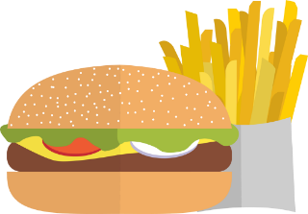
High Cholesterol
What to eat?
What to limit?
Olive and vegetable oils
Fish
Fruits and vegetables
Nuts, walnuts, almonds
Whole grains
Fried foods
High fat dairy (milk and cheese)
High fat desserts and salad dressing
Red meat
Butter and margarine

Slide 30
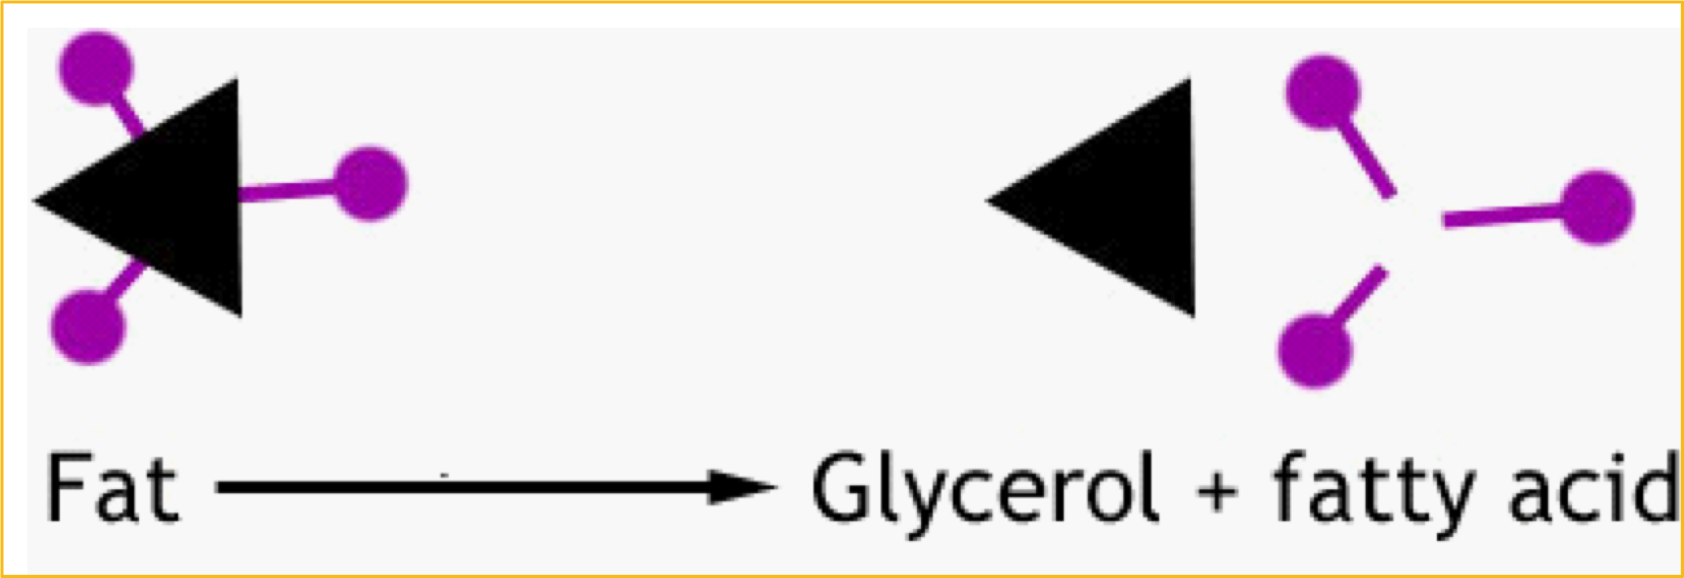
Lipid digestion
Goal of fat digestion:
Breakdown triglycerides
→ Monoglycerides, fatty acids, and glycerol

Slide 31

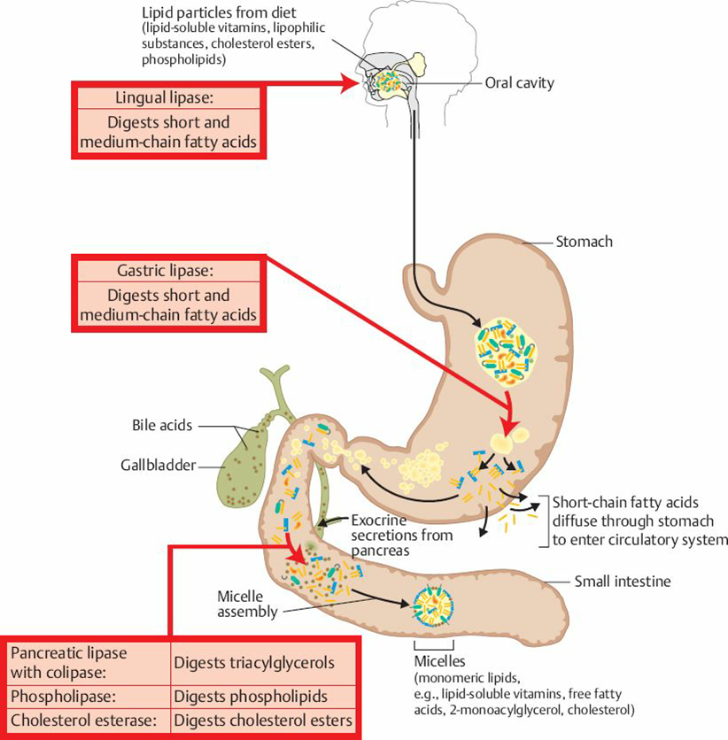
Lipid digestion
In the mouth:
→ Hard fats begin to melt when they reach body temperature
→ Lingual lipase:
An enzyme that starts digestion in the mouth

Slide 32
Lipid digestion
In the stomach:
→ Strong muscle contractions (churning action mixes fat with water and acid)
→ Gastric lipase:
Enzyme that breaks down fat in the stomach

Slide 33
Lipid digestion
In the small intestines:
Cholecystokinin (CCK): A hormone that makes the gall bladder release bile
→ acts as an emulsifier
Pancreatic lipase: An enzyme from the pancreas breaks down triglycerides and phospholipids
→ monoglycerides, glycerol, fatty acids

Slide 34
Health effects of lipids
The blood lipid profile reveals the concentrations of various lipids in the blood
Both the amounts and types of fat in the diet influence the risk for disease
Increase intakes of saturated fat from the diet
Increase risk of cardiovascular disease
Increase LDL cholesterol
Increase intakes of unsaturated fat from the diet
Decrease risk of cardiovascular disease
Decrease LDL cholesterol

Slide 35
Recommended intake of fats
Total Fat
Omega 3 and Omega 6
→ 20 to 35 % of daily energy
Divided between:
→ SFA (7-10%)
→ MUFA (15-20%)
→ PUFA 5-10%
→ Trans FA: as low as possible (Less than 1%)
→ Omega 3 = 0.6-1.2%
→ Omega 6 = 5-10%
Cholesterol
→ 300 mg per day

Slide 36
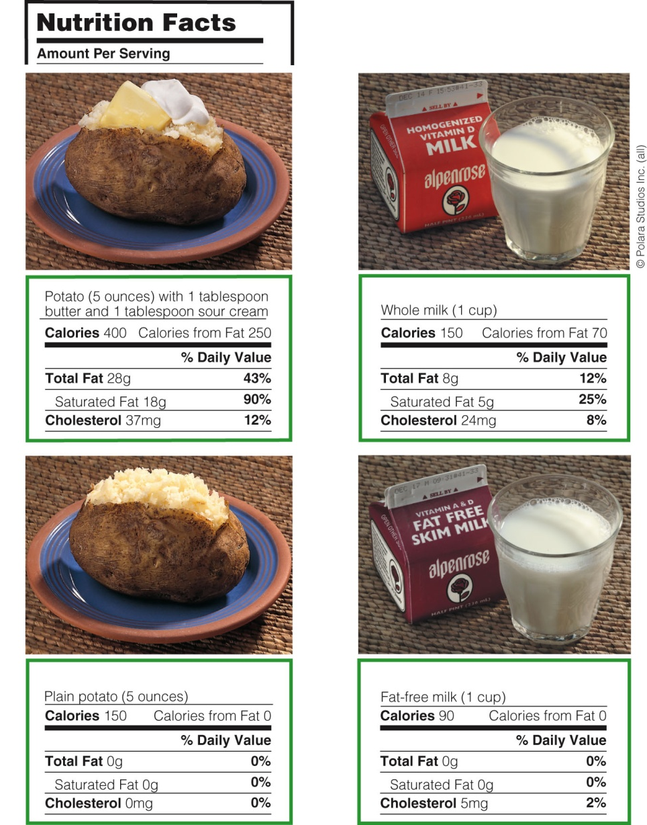
Nutrition Facts and fat on labels

Slide 37
Making wise choices
Watch out for hidden fat or invisible fat
Whole milk, cheese, pastries, cookies, hot dogs, crackers, walnuts, avocados, fast-foods
Check the Nutrition Facts labels of foods
If fat is one of the first ingredients listed → it is probably a high-fat product
If partially hydrogenated vegetable oil is one of the first three ingredients → significant source of trans-fatty acids

Slide 38
Making wise choices
Replace high-fat food
→ with specially manufactured lower-fat versions
Eliminate much of the fat
→ used in seasonings, toppings and salad dressings
Remove the fat
→ from high-fat foods (trim all visible fat and skin from meat and poultry)
Be aware that “fat-free” does not mean “calorie-free”
→ moderation in the use of fat-reduced products which could still be energy dense

Slide 39
Making wise choices
Methods of cooking
→ Recommended methods of cooking include steaming, baking, broiling, grilling or stir-frying in small amounts of oil low in saturated fat but deep-fat frying and pan frying methods should be avoided
Eats fruits and vegetables regularly
→ antioxidant properties (carotenoids, vitamins C and E) → reduce LDL oxidation in the bloodstream and thus slow the progression of CVD
Modify recipes by using low fat ingredients
Find lower-fat foods

Slide 40
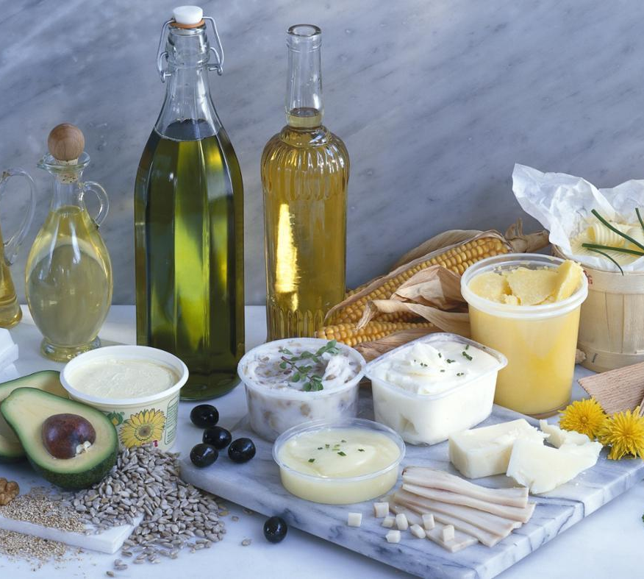
Information for your interest!

Slide 41
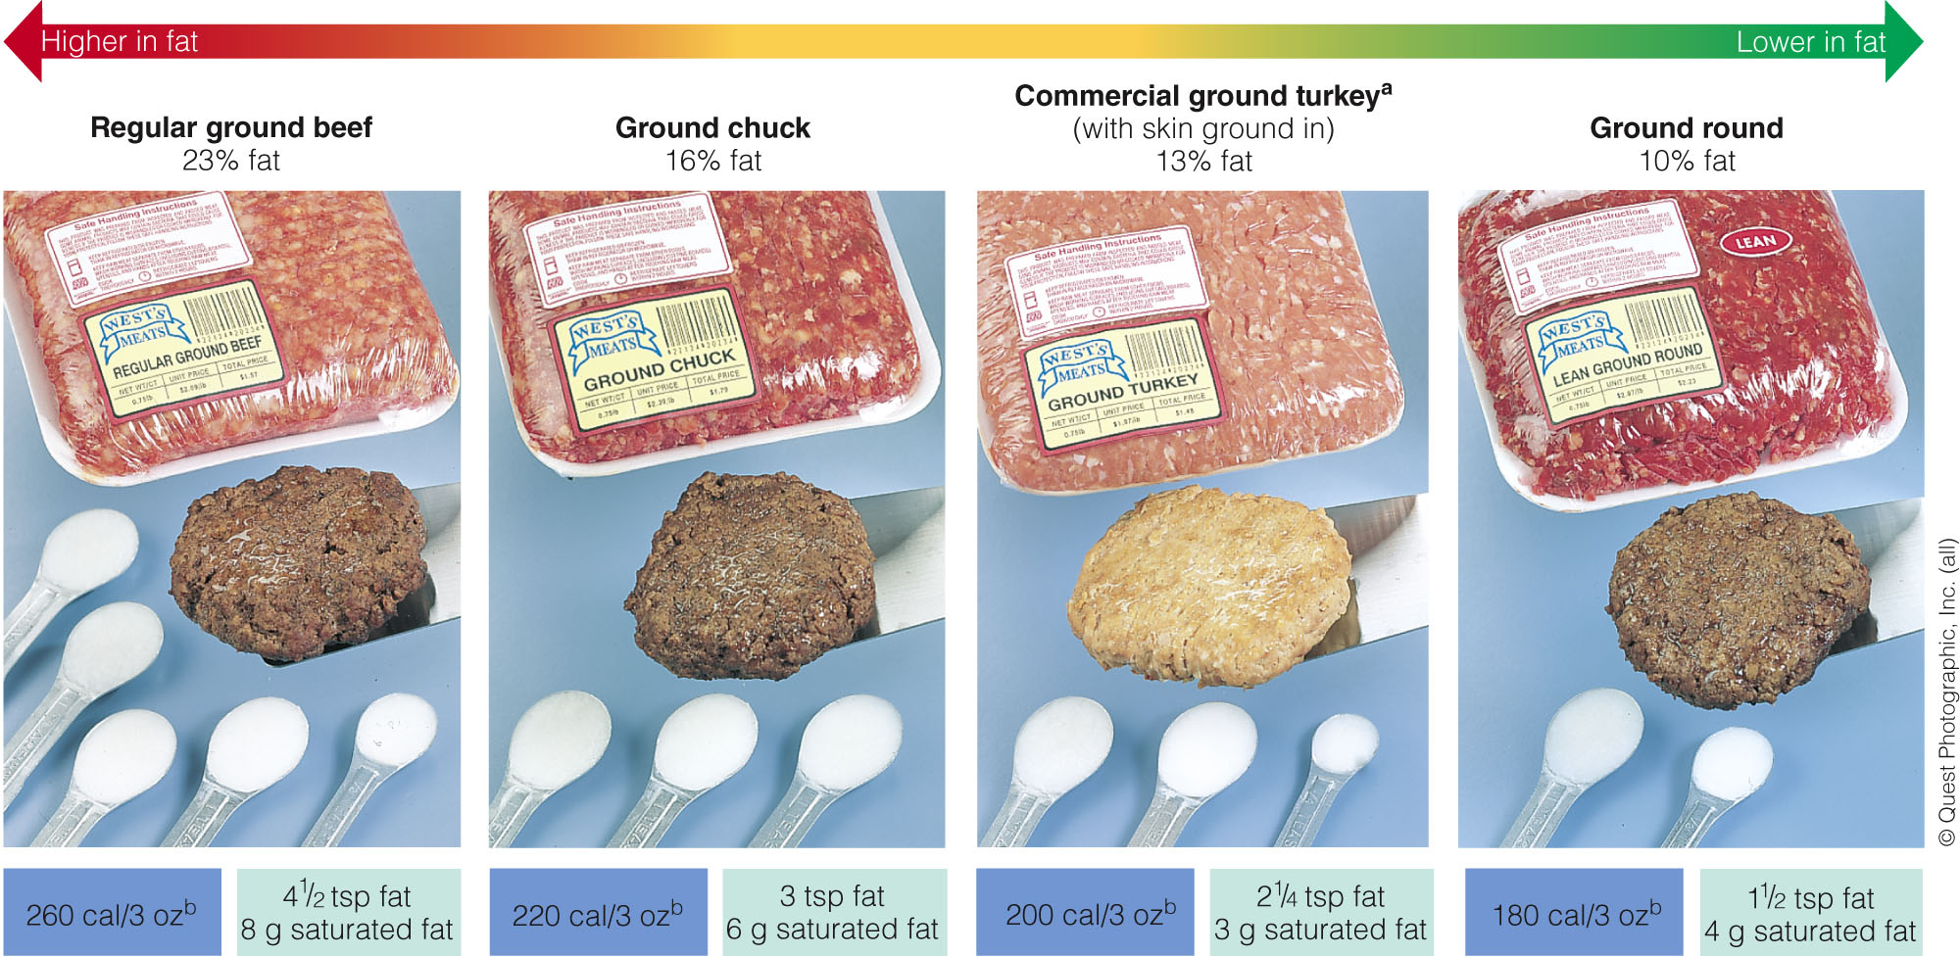
Calories, fat, and saturated fat in cooked ground meat patties

Slide 42
Fats and health
Fatty acid chain length and saturation affects TG’s physical characteristics and storage properties (solid vs. liquid)
Unsaturated fatty acids are usually liquid at room temperature and healthy
The more saturated the fat the more solid it is at room temperature and is usually unhealthy (with the exception of fish)
SFA and trans fatty acids are unhealthy and when eaten in excess increase the risk of heart disease and increase LDL levels (unhealthy blood cholesterol)

Slide 43
Fats and health
Effects of eating different kinds of fatty acids on health
MUFA & PUFA | Lowers LDL cholesterol and increases HDL cholesterol (good cholesterol)
Saturated Fatty Acids & Trans Fatty Acids | Raises LDL cholesterol (bad cholesterol)

Slide 44
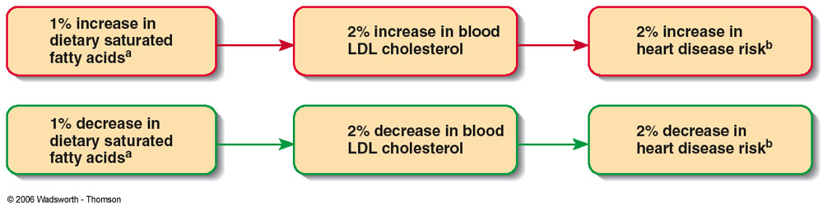
Fats and health
High intake of saturated and trans fats
High LDL in the blood
Increased risk of atherosclerosis / strokes / heart attacks

Slide 45
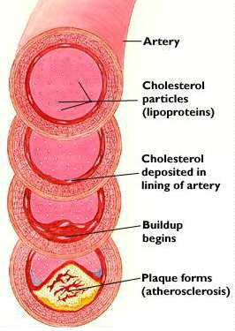
Fats and health
High intake of saturated and trans fats
Increase the risk of certain cancer
Increase the risk of obesity
High intake of MUFA and PUFA and especially omega 3 (ω3)
Very beneficial for health and protects against heart disease

Slide 46
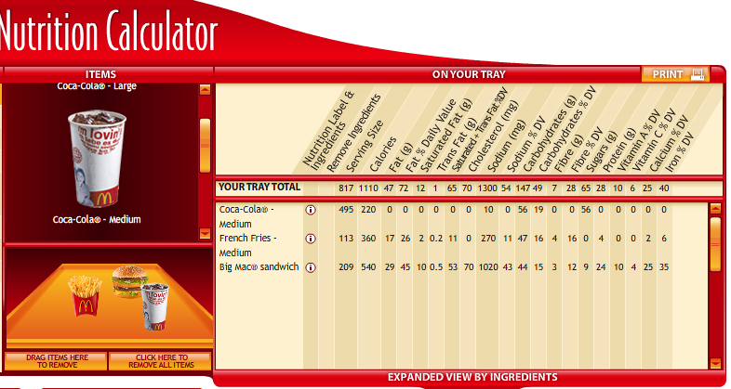
Choosing healthier fast food

Slide 47
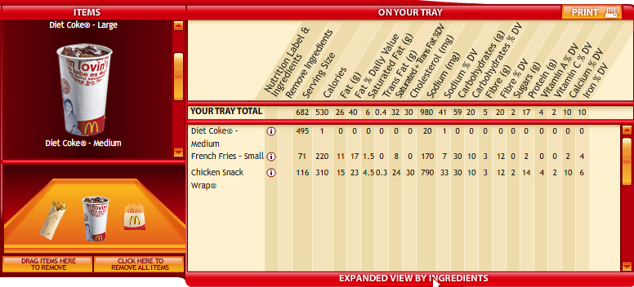
1-NATURE

Slide 48
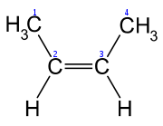
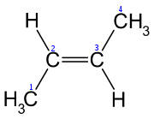
Hydrogenation
A chemical process by which hydrogens are added to fatty acid double bonds
Unsaturated fats are more prone to oxidation due to the instability of the double bond
Unsaturated Saturated (or trans)
Cis
Trans

Slide 49
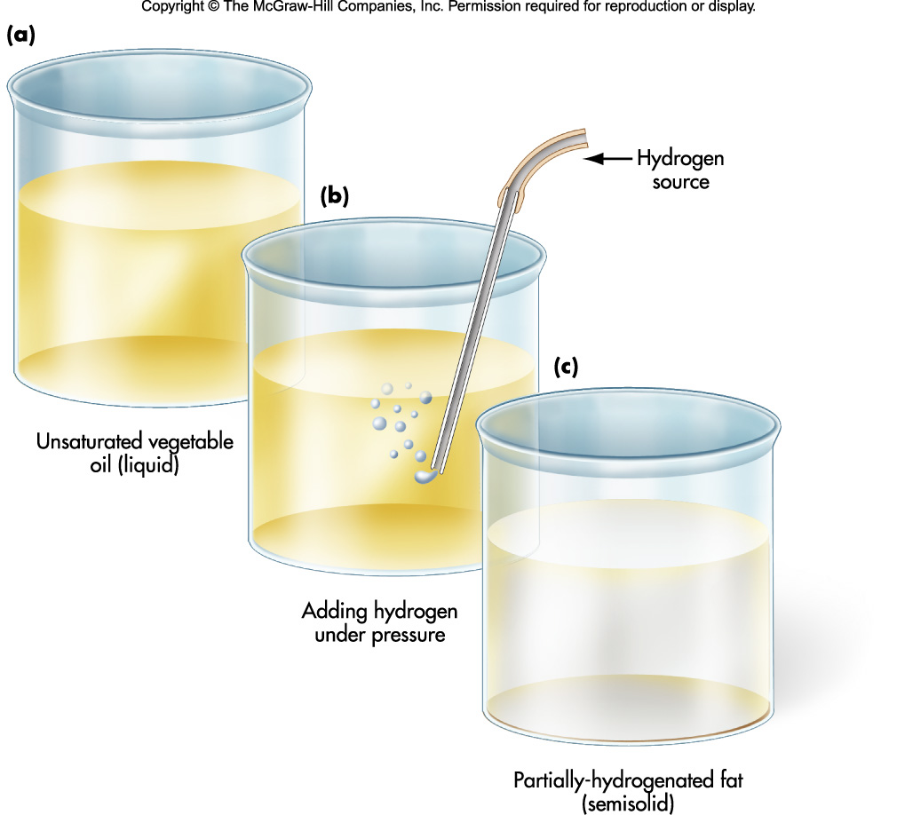
Hydrogenation

Slide 50
Hydrogenation
Advantages
Renders the oil more stable and resistant to oxidation, hence a longer shelf life
Alters the texture of foods (spreadable: margarine)
Disadvantages
Makes polyunsaturated fats more saturated, consequently less healthy
Produces trans-fatty acids that behave more like saturated fats than unsaturated (thus LDL)

Slide 51
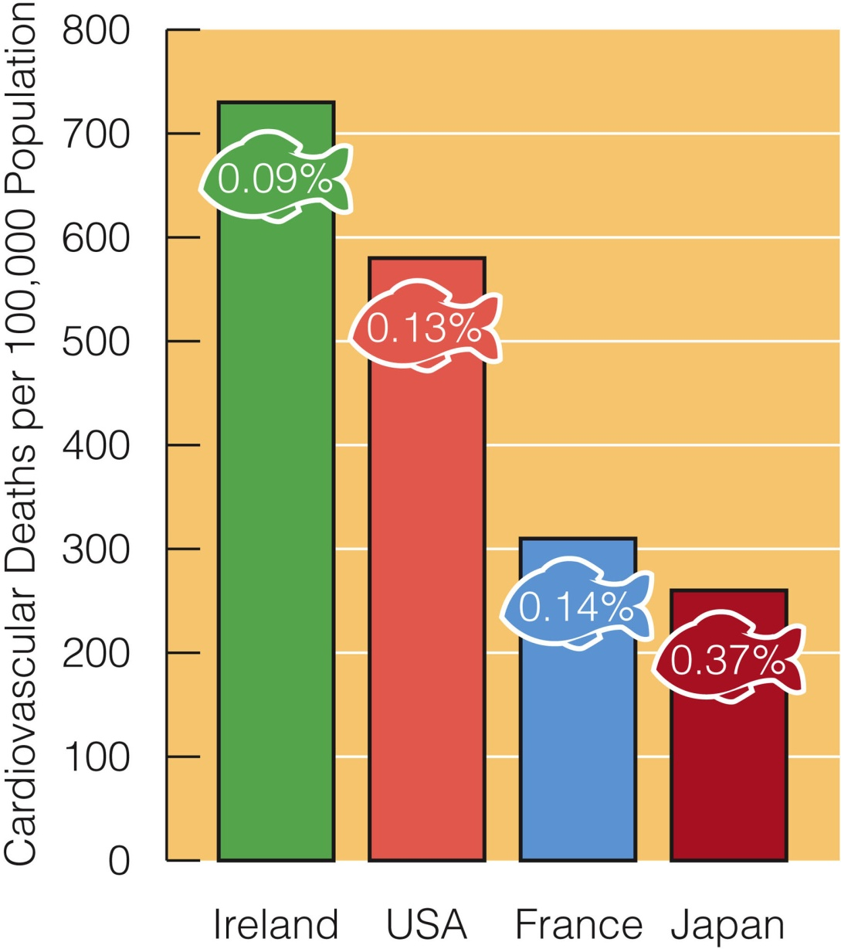
Fish oil intakes and cardiovascular death rates

Slide 52
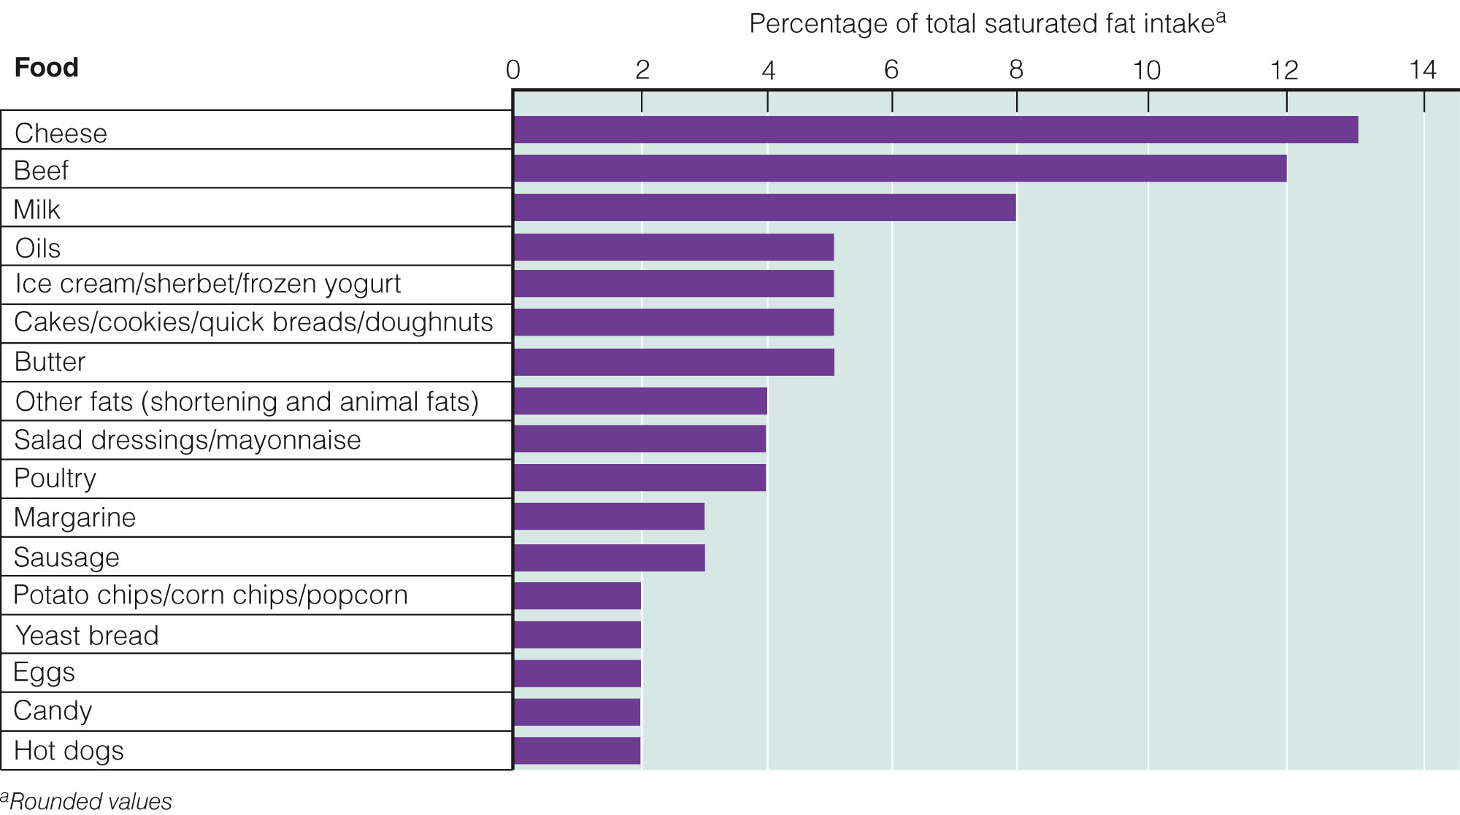
Top contributors of saturated fats in diet

Slide 53
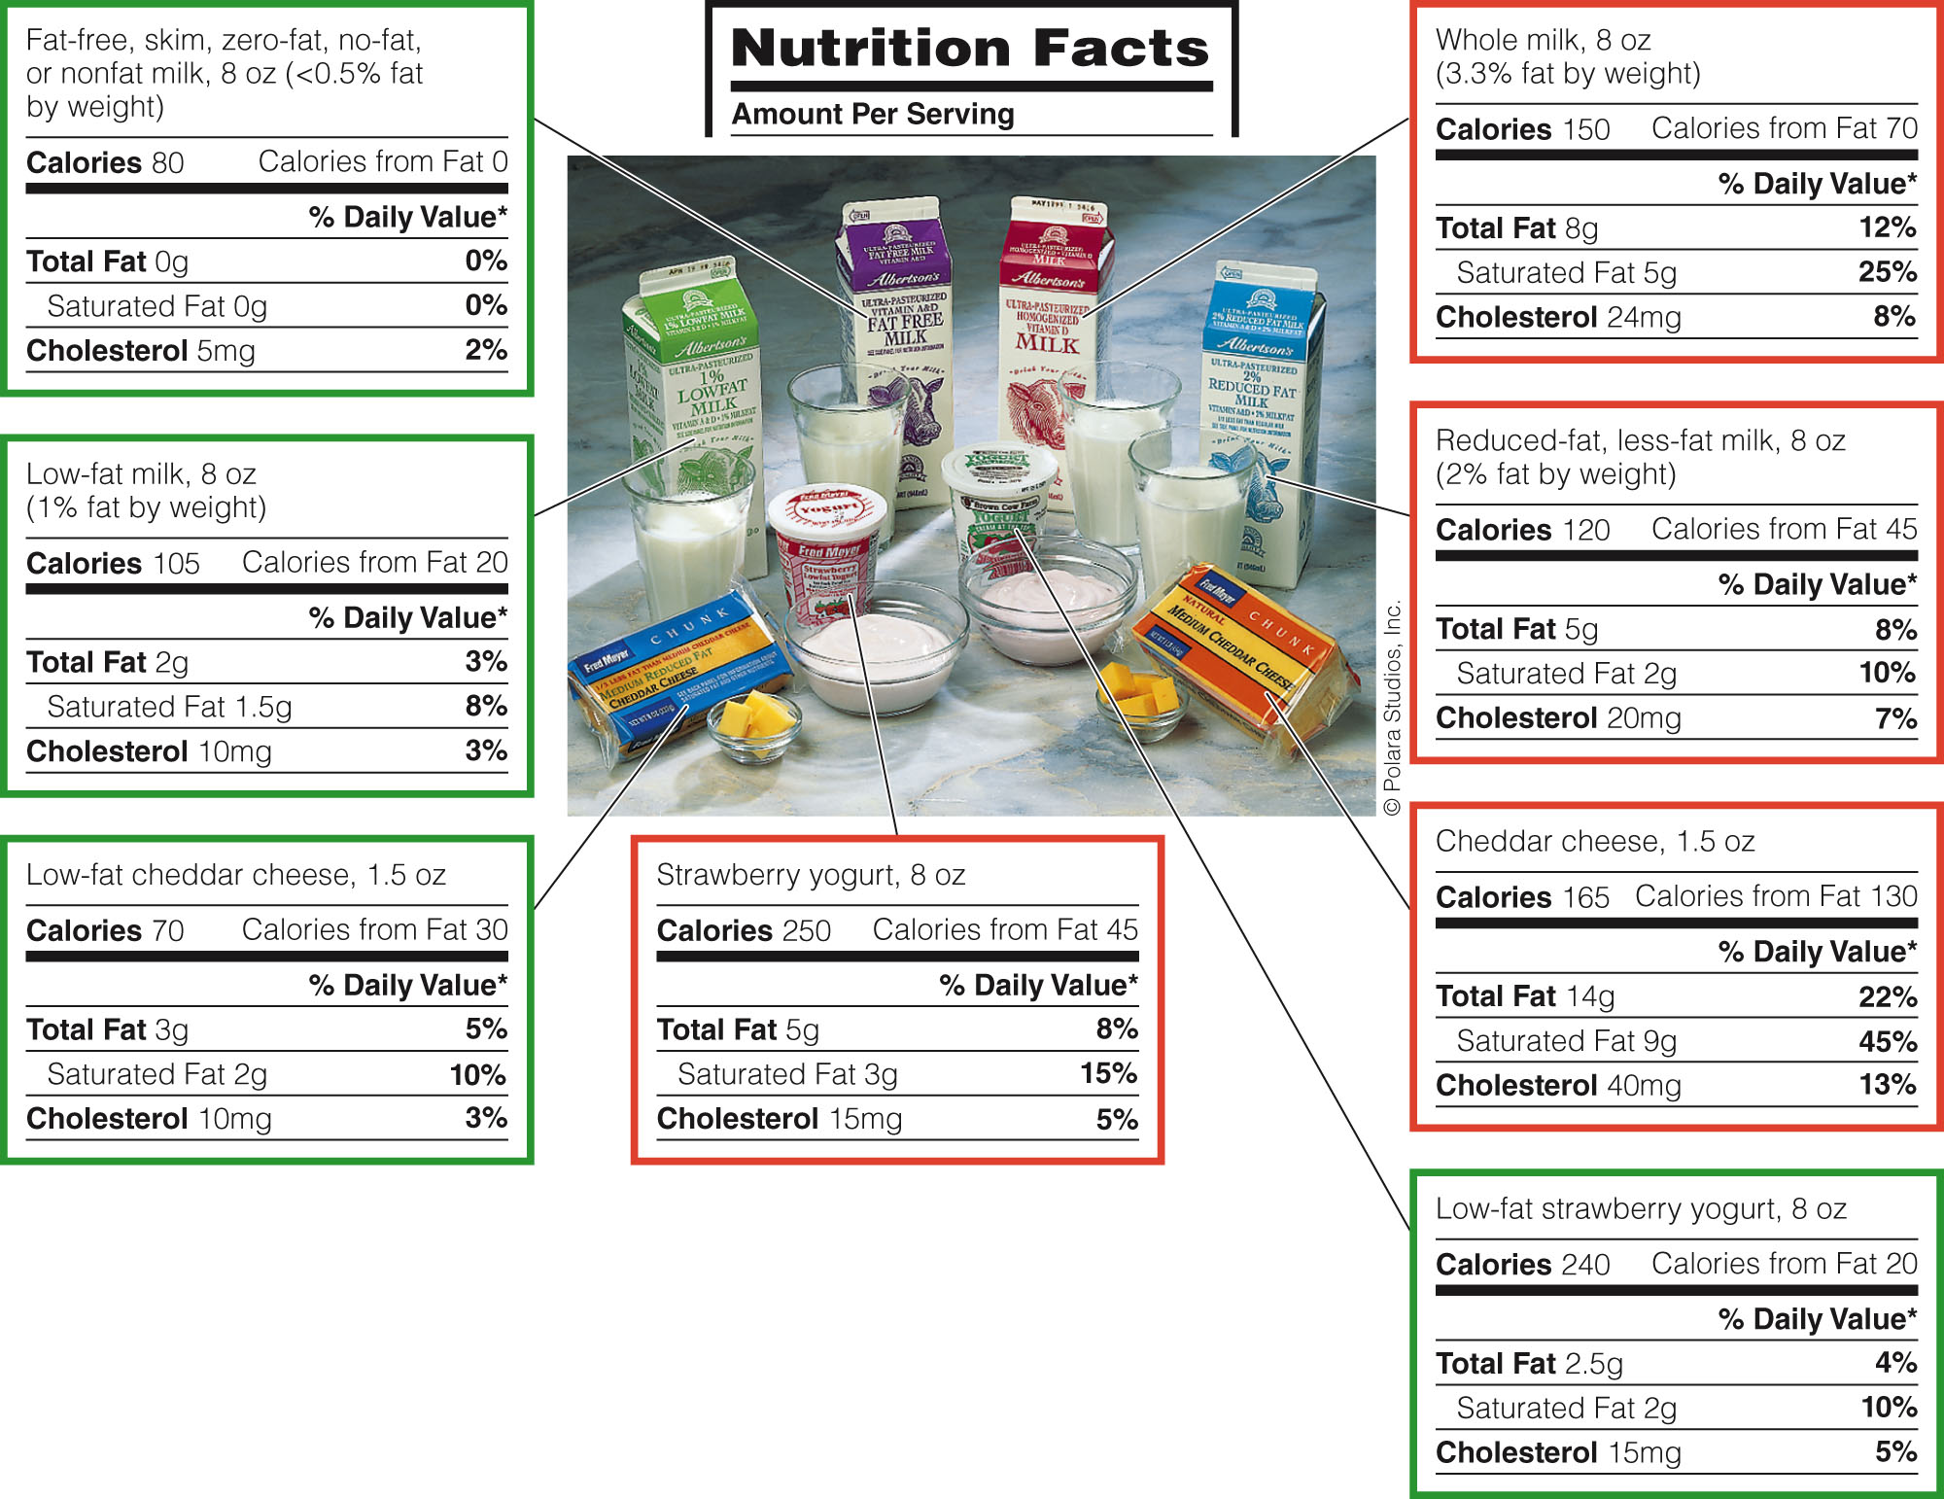
Lipids in milk, yogurt, and cheese

Slide 54
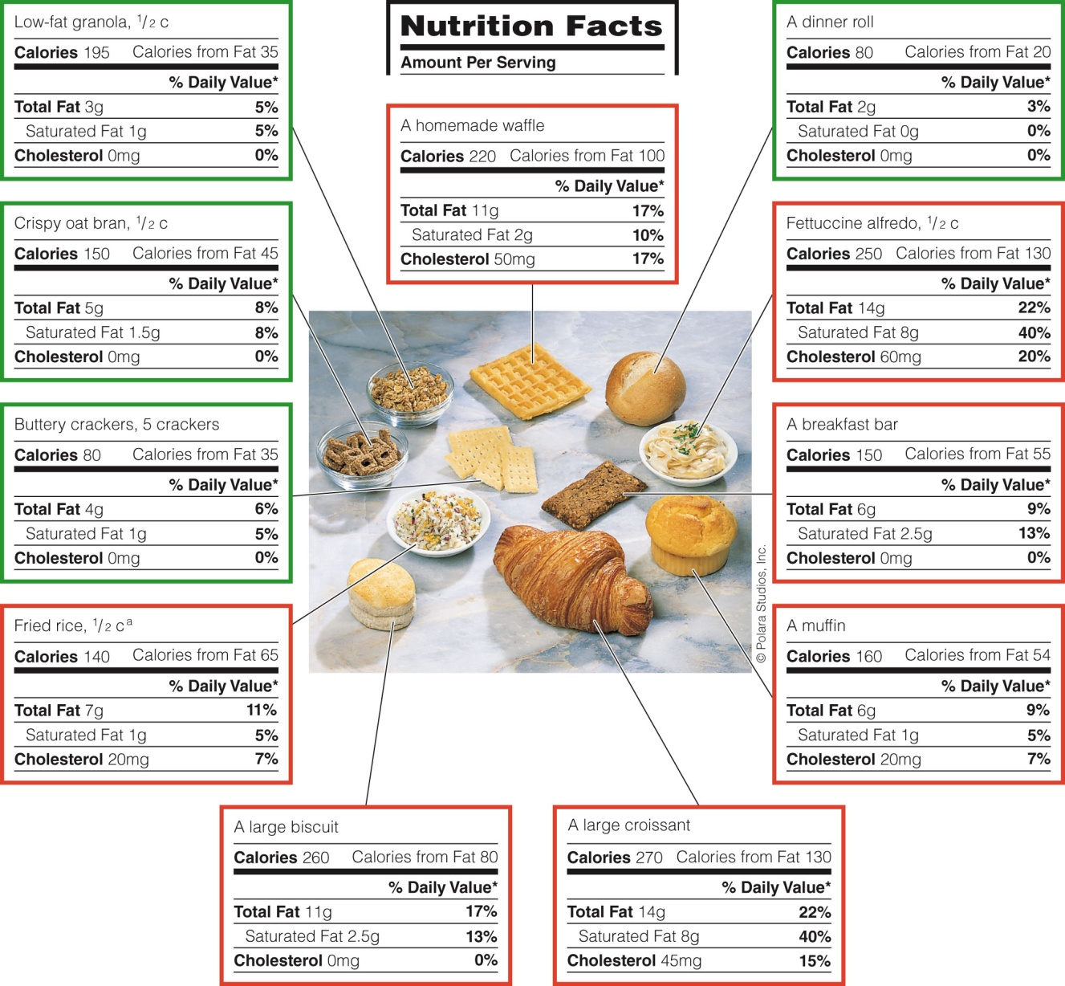
Lipids in bread, cereal, rice and pasta

